Slide 1

Building an Optimized Infrastructure
Samm DiStasio
Director
Infrastructure Optimization Strategy
Microsoft Corporation
Richard McKinney
Government Technology Advisor / S&LG
Microsoft Corporation
richard.mckinney@microsoft.com

Slide 2


Background
Infrastructure Optimization Overview
An example
The benefits of the journey
How we engage with customers
Demo - ROI Analysis Tool

Slide 3

My public sector background
CIO
Metropolitan Govt of Nashville & Davidson Co
1999-2005
IT Director
Tennessee General Assembly
1995-1999
Asst Commissioner / Administration
TN Dept of General Services
1987-1995
Information Technology Consultant
TN Dept of Finance and Administration
1985-1987

Slide 4


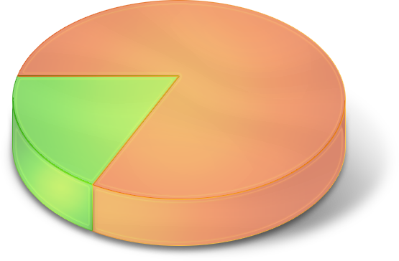









More Pressure Than Ever On IT
Technology
Change
Regulatory
Compliance
Competition
Security
Cost
Reduction
Keep Enterprise
Up & Running
Customer
Connection
End User
Productivity
Business Results
& New Value

Slide 5


Slide 6

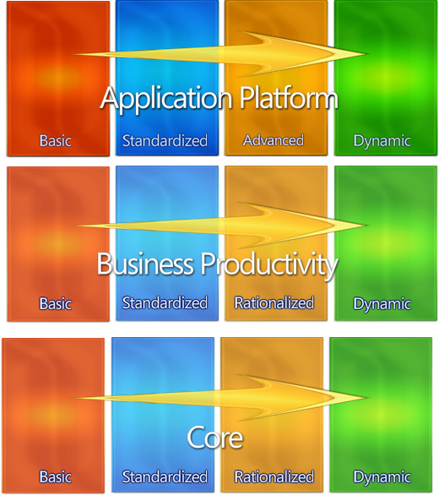

A Blueprint To Overcome The Challenges
Infrastructure optimization
A Model-based Approach
Capability sequencing framework to help you build an optimized infrastructure (not Microsoft-specific)
Grounded in industry analyst and academic work, consortium work coming
Provides guidance and best practices for step-by-step implementation
Drives cost reduction, security and efficiency gains as well as enabling agility
6

Slide 7






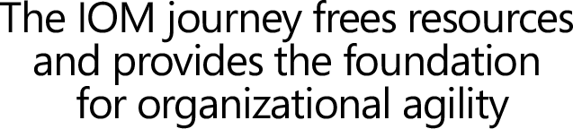




Getting There From Here
The infrastructure optimization journey
Uncoordinated, manual
Infrastructure
Knowledge not captured
Managed IT
Infrastructure
with limited
automation and knowledge capture
Managed and
consolidated IT
Infrastructure
with extensive
Automation, knowledge captured and re-used
Fully automated
management,
dynamic resource
Usage , business
linked SLA’s. Knowledge capture automated and use automated
Cost Center
More Efficient Cost Center
Business Enabler
Strategic Asset

Slide 8



Core Model Capabilities
IT and Security Process
Identity and Access Management
Desktop, Server and Device Management
Security and Networking
Data Protection and Recovery

Slide 9
Technology View of Model
No common identity management model
Identity management for user identification
Centralized configuration and authentication, information protection infrastructure
Centralized administration, Federated Identity Management
No server-based identity or access management
Users operate in admin mode
Limited or inconsistent use of passwords at the desktop
Minimal enterprise access standards
Directory Services for Authentication and Authorization
Users have access to admin mode
Security templates applied to standard images
Desktops not managed by policy
Policy
and Security templates used to manage desktops for security
and settings
Directory and certificate-based Information Protection Infrastructure
Certificate Provisioning & Authorization for Mobile Devices
Centrally manage users provisioning across heterogeneous systems
Federated Identity Management across organizational and platform boundaries

Slide 10

Infrastructure Optimization And IT Performance
 | Basic | Standardized | Rationalized
IT costs | $1,320 | $580 | $230
Service Levels (# Svc Desk Calls) | 8.4 | 8.5 | 7.7
Business Agility (# weeks) | 5.4 | 5.2 | 4.3
IT Labor Costs @ $53/hour
  Service Desk
    Help Desk
    Deskside
  Desktop Engineering and Support
    Image Management
    Security
    Software and Patch Deployment
    PC Management Infrastructure
    Data Management
Service Levels
Quality and Timeliness of IT Services
Number of Services Desk Calls (Proxy)
Business Agility
Time required to provide new IT Services
Number of weeks for new LOB App (Proxy)

Slide 11
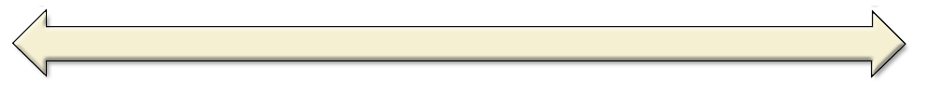
Best Practices for Infrastructure Optimization
$1,320/PC
$580/PC
$230/PC
Standardization & Standards Compliance = $300/PC Savings
None
No PC life cycle strategy
No policy based PC mgt
Many hw, sw configs
Standardization
Defined PC lifecycle
Limited policy based PC mgt
Many software configs
Stds Compliance
Defined PC Lifecycle, stds enforcement
Full policy based PC mgt
Minimal hw, sw configs
Identity & Access Management = $170/PC Savings
Multiple Directories
Many auth. directories
No dir synchronization
Manual user provisioning
Single directory for Auth
One authentication dir.
Automated provisioning
Single Sign-on
Auto password reset
Auto user provisioning
PC Security = $130/PC Savings
Minimal PC Security
Anti-virus
Manual patching
No enforced sec. compliance
Limited PC Security
PC firewall
Auto patching
Comprehensive PC Security
Anti Spyware
Enforced security compliance
with Network Access Control
Systems Management = $230/PC Savings
No system-wide mgmt
Poor sys mgt tool coverage
Duplicate mgmt tools
Manual sw, patch deploymt
Limited sys mgmt
Single sys mgt tool
Software packaging
Software distribution
Comprehensive sys mgt
Hw, sw inventories
Hw, sw reporting
Auto/targeted sw dist.
Source: IDC, 2006
Notes:
The Infrastructure Optimization Model from Microsoft has been developed using Industry best practices, Microsoft’s own experiences with its enterprise customers, and is based upon Gartner’s Infrastructure Maturity Model and MIT’s Architecture Maturity Model. A key goal for Microsoft in creating the Infrastructure Optimization Model was to develop a simple way to use a maturity framework that is flexible and can easily be used as the benchmark for technical capability and business value.
The Infrastructure Optimization Model from Microsoft helps customers understand and subsequently improve the current state of their IT infrastructure and what that means in terms of cost, security risk and operational agility. Dramatic cost savings can be realized by moving from an unmanaged environment towards a dynamic environment. Security improves from highly vulnerable in a Basic infrastructure, to dynamically proactive in a more mature infrastructure. IT Infrastructure Management changes from highly manual and reactive to highly automated and proactive. Microsoft and Partners can provide the technologies, processes and procedures to help customers move up through the Infrastructure Optimization Journey. Process moves from fragmented or non-existent to optimized and repeatable. A customer’s ability to use technology to improve their business agility and deliver business value increases as they move from the Basic state up the continuum toward a Dynamic state empowering information workers, managers and supporting new business opportunities.
By working with Microsoft and using this model as a framework, an enterprise can quickly understand the strategic value and business benefits to the organization in moving from a “basic” level of maturity (where the IT infrastructure is generally considered a “cost center”) towards a more “dynamic” use when the business value of the IT infrastructure is clearly understood and the IT infrastructure is viewed as a strategic business asset and business enabler.

Slide 12




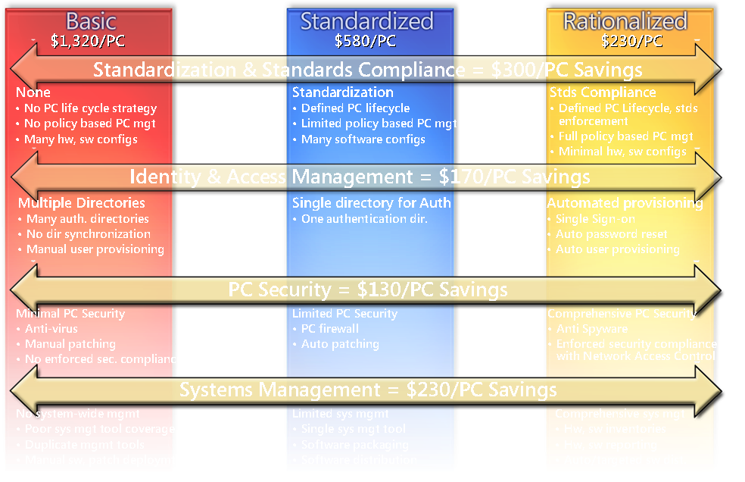
A Framework for Applying Best Practices
Service Level Planning
Capacity planning
Availability planning
Security planning
Infrastructure planning
Service continuity planning
Change management
Configuration management
Release management
Plan/
Optimize
Change
+
MOF
Best Practices
Support
Operate
Service monitoring
Systems administration
Network administration
Directory administration
Security administration
Storage management
Service desk
Incident management
Problem management

Slide 13

Best Practices Across Lifecycle Yield Optimization
PCs/ IT FTE
76
$1,320/PC
172
$580/PC
442
$230/PC
600
500
Plan/
Optimize
Change
Change
Plan /
Optimize
400
Operate
Support
Support
Operate
300
Plan/
Optimize
Change
200
Plan/
Optimize
Change
Operate
Support
Improve IT efficiency
Increase agility
Shift investment mix
100
Operate
Support
0
Note: $/PC represent annual IT labor per PC
Source: IDC, 2006; Microsoft studies, 2005-06
Notes:
The Infrastructure Optimization Model from Microsoft has been developed using Industry best practices, Microsoft’s own experiences with its enterprise customers, and is based upon Gartner’s Infrastructure Maturity Model and MIT’s Architecture Maturity Model. A key goal for Microsoft in creating the Infrastructure Optimization Model was to develop a simple way to use a maturity framework that is flexible and can easily be used as the benchmark for technical capability and business value.
The Infrastructure Optimization Model from Microsoft helps customers understand and subsequently improve the current state of their IT infrastructure and what that means in terms of cost, security risk and operational agility. Dramatic cost savings can be realized by moving from an unmanaged environment towards a dynamic environment. Security improves from highly vulnerable in a Basic infrastructure, to dynamically proactive in a more mature infrastructure. IT Infrastructure Management changes from highly manual and reactive to highly automated and proactive. Microsoft and Partners can provide the technologies, processes and procedures to help customers move up through the Infrastructure Optimization Journey. Process moves from fragmented or non-existent to optimized and repeatable. A customer’s ability to use technology to improve their business agility and deliver business value increases as they move from the Basic state up the continuum toward a Dynamic state empowering information workers, managers and supporting new business opportunities.
By working with Microsoft and using this model as a framework, an enterprise can quickly understand the strategic value and business benefits to the organization in moving from a “basic” level of maturity (where the IT infrastructure is generally considered a “cost center”) towards a more “dynamic” use when the business value of the IT infrastructure is clearly understood and the IT infrastructure is viewed as a strategic business asset and business enabler.

Slide 14

The Infrastructure Optimization Journey
Work with Microsoft and/or our Partners to help you get started
  Assess your IT capability against the models
  Prioritize and identify capability gaps required to support your business
  Build a multi-year plan with Microsoft and our partners that maps to your business and IT priorities
  Review and tune with your Microsoft and partner teams on an ongoing basis

Slide 15
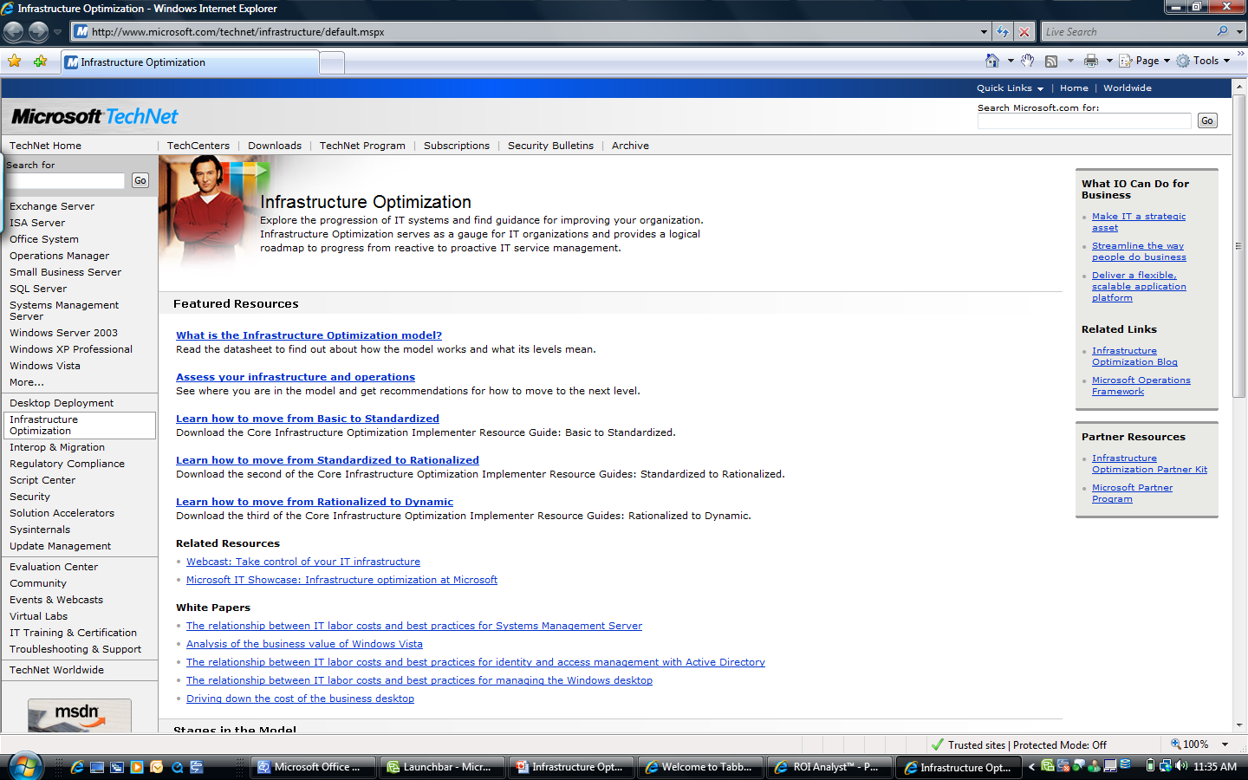
www.microsoft.com/io

Slide 16
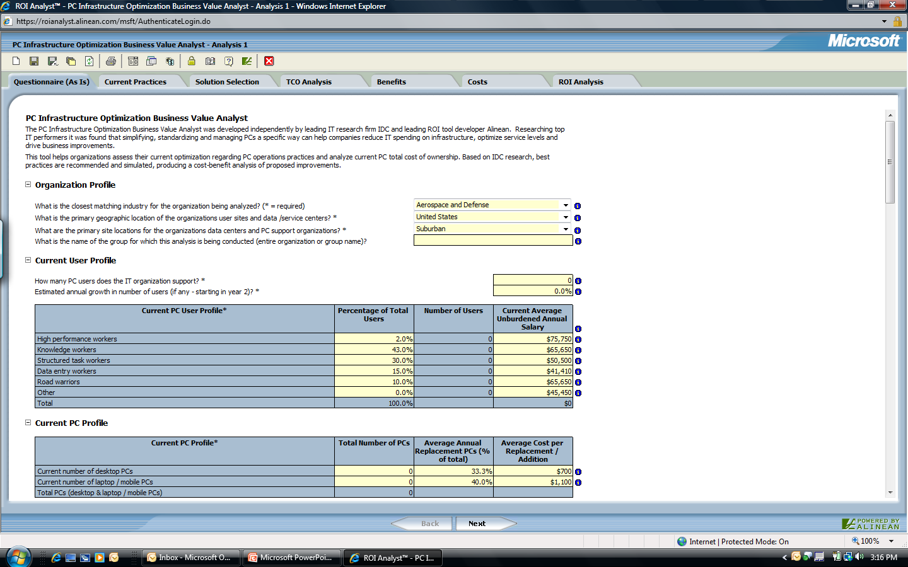
https://roianalyst.alinean.com/microsoft/iotool/launch.html

Slide 17


© 2006 Microsoft Corporation. All rights reserved. Microsoft, Windows, Windows Vista and other product names are or may be registered trademarks and/or trademarks in the U.S. and/or other countries.
The information herein is for informational purposes only and represents the current view of Microsoft Corporation as of the date of this presentation. Because Microsoft must respond to changing market conditions, it should not be interpreted to be a commitment on the part of Microsoft, and Microsoft cannot guarantee the accuracy of any information provided after the date of this presentation.
MICROSOFT MAKES NO WARRANTIES, EXPRESS, IMPLIED OR STATUTORY, AS TO THE INFORMATION IN THIS PRESENTATION.

